Slide 1
Introduction to Traffic Calming
“vekehrsberuhigung”
Trent McLaughlin, P.Eng.

Slide 2
Background
Mackenzie County Council tasked administration to look into the possibility of Speed Bumps or Swales as a method of slowing down traffic on some roads in the Hamlet of LaCrete.

Slide 3
Definition
“Traffic calming consists of physical design and other measures, including narrowed roads and speed humps, put in place on roads for the intention of slowing down or reducing motor-vehicle traffic as well as to improve safety for pedestrians and cyclists.”
https://en.wikipedia.org/wiki/Traffic_calming

Slide 4
Measures
Traffic engineers refer to three "E's" when discussing traffic calming: engineering, (community) education, and (police) enforcement. Because neighborhood traffic management studies have shown that residents often contribute to the perceived speeding problem within their neighborhoods, instructions on traffic calming stress that the most effective traffic calming plans entail all three components—that engineering measures alone will not produce satisfactory results.
https://en.wikipedia.org/wiki/Traffic_calming

Slide 5
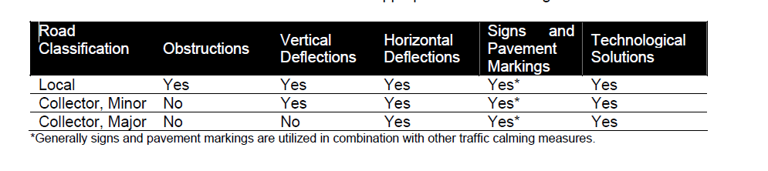
Types of Engineered Solutions

Slide 6
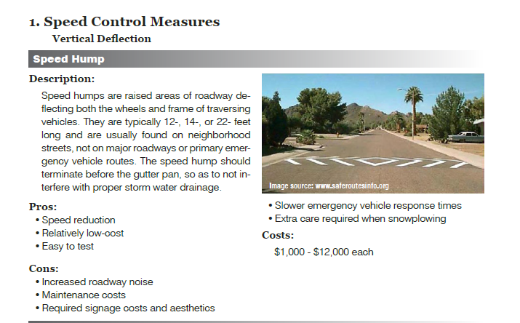
Speed Humps
http://www.scrcog.org/documents/TrafficCalming_ResourceGuide_Final.pdf

Slide 7
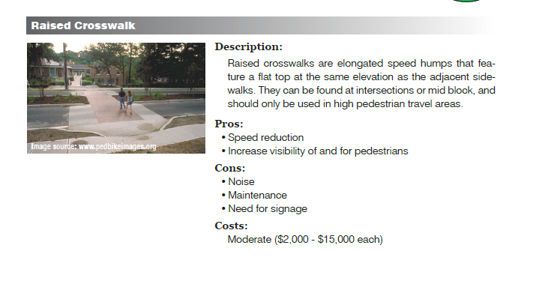
Raised Crosswalks

Slide 8
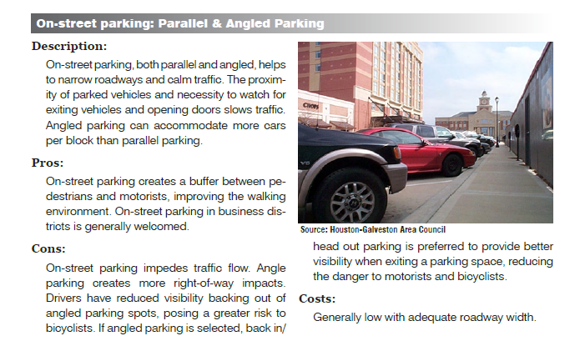
Parallel & Angled Parking

Slide 9
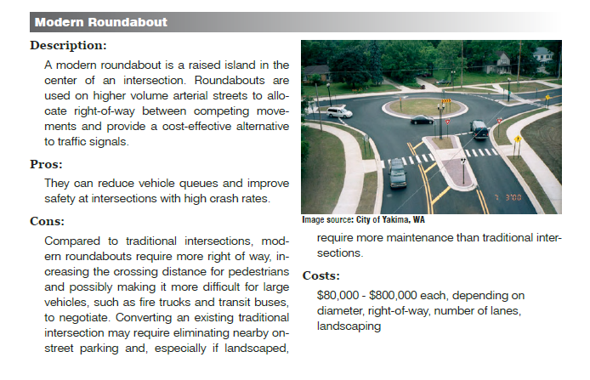
Roundabout

Slide 10
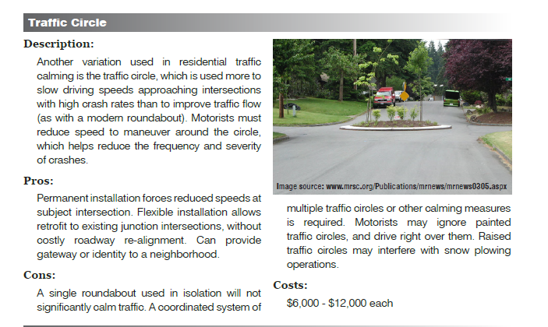
Traffic Circle

Slide 11
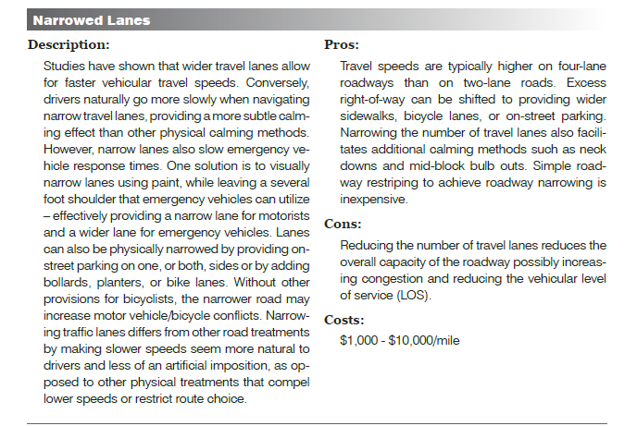
Narrow Lanes

Slide 12
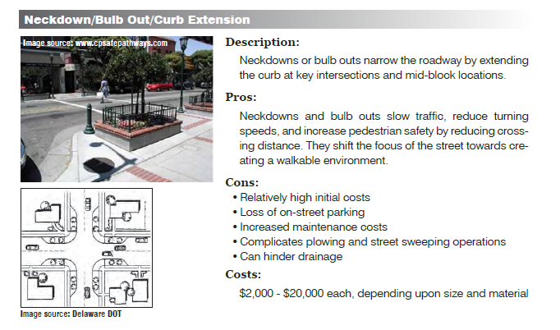
Curb Extentions

Slide 13
Swales
No documentation could be found listing swales as a traffic calming alternative. Swales are a component of the storm water collection system.
To install them where they are not needed for drainage, would cause icing and other maintenance problems.
Swales would also be more expensive than speed bumps, with no benefits above them.

Slide 14
Conclusions and Recommendations
Many different alternatives exist and the problems and solutions should be well studied before making any decisions.
You need community input in your solutions for them to work.
Include Enforcement and Education as important parts of the solutions.

